Slide 1
Building Equity for Middle School Boys
Dr. Carlessia Hussein Minority Scholarship Fund Raiser
Seasons 52 Restaurant
September 1, 2018

Slide 2
FOCUS
WHO?
Males of Middle School Age
Black and Hispanic
Lower Graders
Lower Income

Slide 3
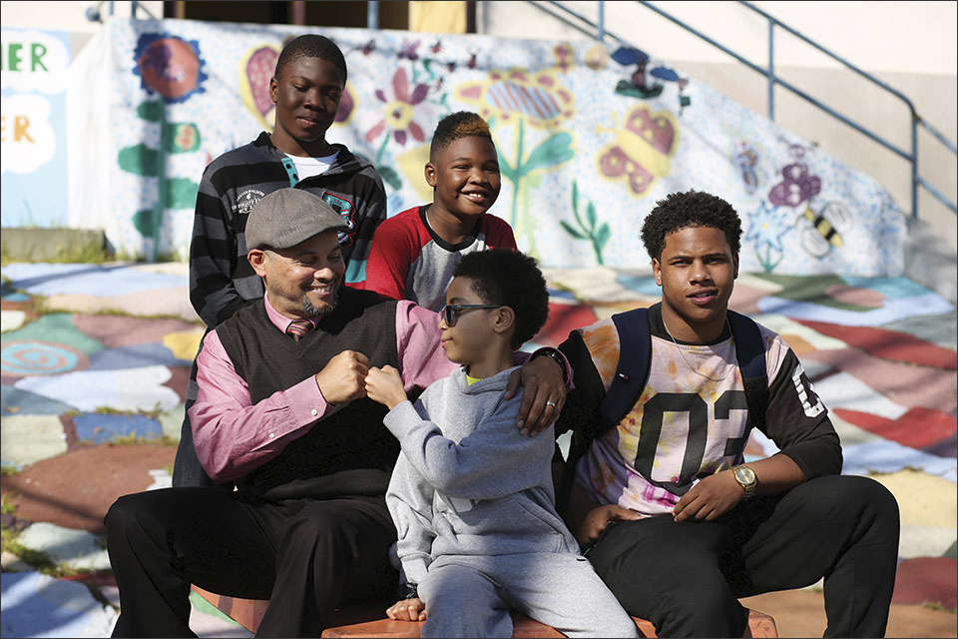
FOCUS
WHY MALES?
47% preschoolers suspended are Black
18% of all boys suspended are Black, 6.8% are Hispanic
61% of Blacks & 51% of Hispanic children experience Adverse Childhood Experiences ACEs – (Abuse, Murder, Divorce, Poverty)
More males than females in Juvenile Justice System

Slide 4
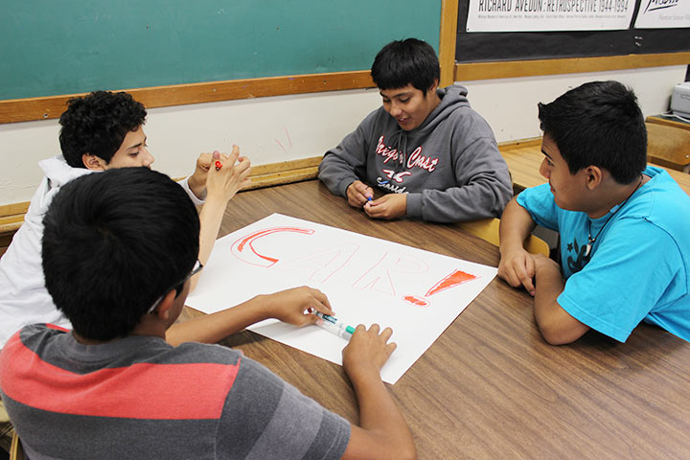
FOCUS
WHY MIDDLE SCHOOL?
Start of puberty
Industry vs. inferiority
Seeking place (worth) in world
Highly influenced by society and peers
High levels of peer competition among males begin

Slide 5
Opportunities for Minority Boys IN POVERTY Matter
Minority boys experience the brunt of society’s unconscious bias and negative stereotyping
High school suspensions, childhood trauma and sustained poverty are the leading predictors of failure in school and in life

Slide 6
Opportunities for Minority Boys IN POVERTY Matter
Poverty can turn young boys into homeless men
Family resources needed to enter school ready to learn

Slide 7
Howard county public schools
20 middle schools population – 13,180 (2017-2018)
Free/Reduced Lunch (FRL) all schools – 22.1%
9 Middle schools have 24% to 52% FRL students
42 boys received scholarships by end of 3rd year, 2018

Slide 8
A supporter says
“I am proud that the Hussein Minority Fund is working to connect children with opportunities to learn and grow.”
– U.S. Senator Ben Cardin
(September 1, 2018)

Slide 9
A supporter says
“The Dr. Carlessia Hussein Minority
Scholarship Program provides
challenging, educational experiences
for young minority boys to help
them achieve in schools, build
leadership skills and chart a course
to fulfill their future dream.”
–Elijah E. Cummings
Maryland Member of Congress
(September 1, 2018)

Slide 10
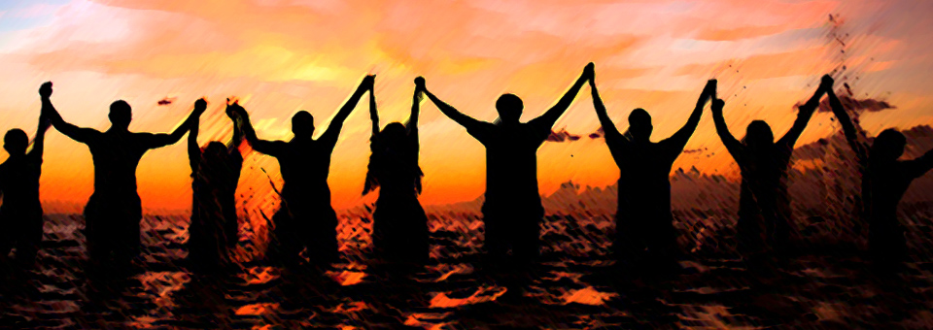
From the Mouths of the Boys
“This program would enrich my knowledge and prepare me for the future, just like Dr. Seuss said ‘The more you read the more places you’ll go. I hope to learn how to speak in front of people.’”
“I think it is a really nice program. I really enjoy JavaScript its one of my passions. So, I think this would be a really good thing for me.”
“I want to participate in this program to learn how to create game apps.”
“I want to build, create, and discover through artistic engineering. I hope to learn a lot.”
“I want to participate so that I can go advanced with my education.”

Slide 11
CONTACT
Dr. Carlessia A. Hussein
www.opportunity-and-health.com
cahussein@verizon.net
“GIVE LOCAL”
To Donate
http://cfhoco.org/fund/carlessia-hussein-minority-scholarship-fund/

